Slide 6
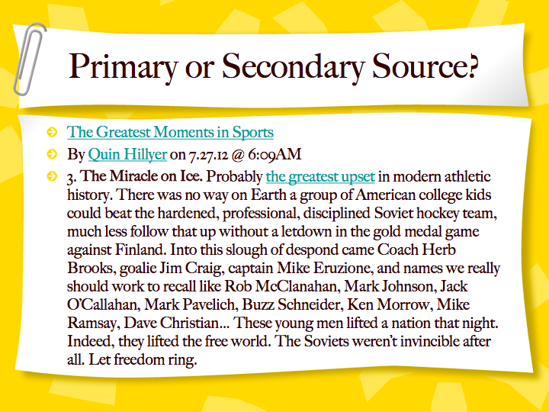

Slide 7
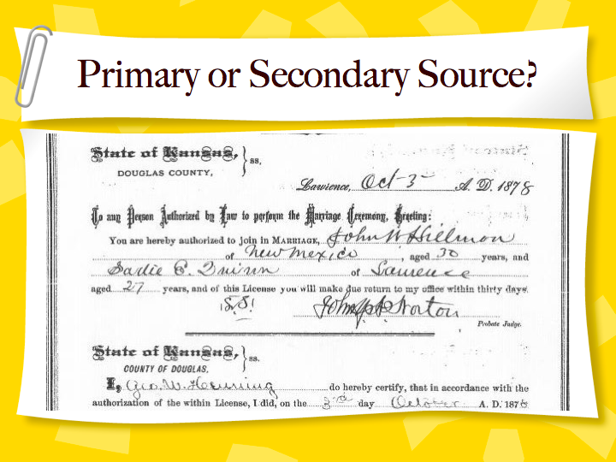

Slide 8
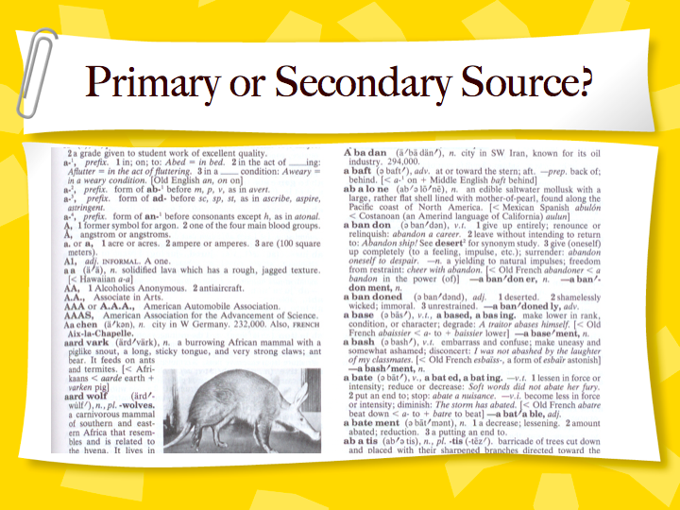

Slide 9
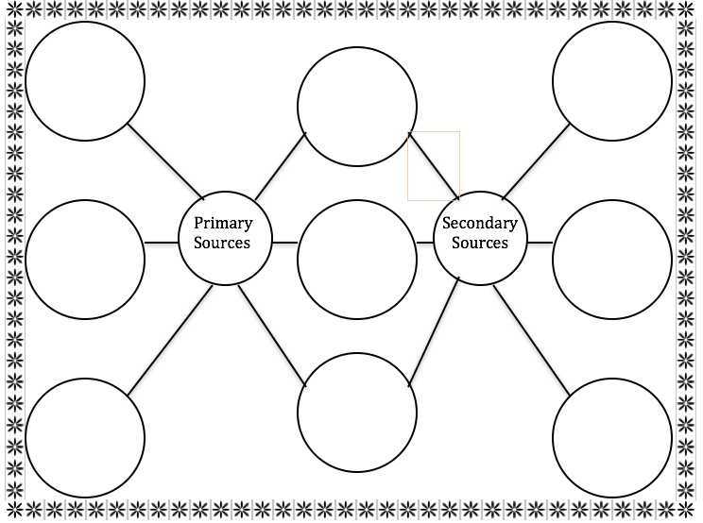
Primary vs Secondary Sources Double Bubble Map
On page ________, create a double bubble map.
Compare and contrast the two types of sources

