Slide 1
DO NOW
Write down homework- UNIT TEST ON 12/21
Set up your notebooks:
12/6 Whiskey and Fries’s Rebellions p.. 30
12/6 Constitutional Convention CN p. 31
30
Whiskey and Fries’s Rebellion
Constitutional Convention CN
31

Slide 2
On the guided notes given, fill in the following:
Topic: The New and Improved Government- The Constitution
EQ: How did the Constitution set up the American government? What role did compromises play in creating the Constitution?

Slide 3
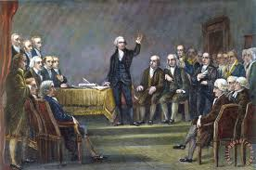
What happened at the Convention?
Originally wanted to fix the Articles of Confederation
12 of the 13 states attended (Rhode Island feared a strong national government and boycotted the meeting)
Delegates were “well-bred, well-fed, and well-read”
A secret meeting
Delegates had a lot in common but also many different views on key issues

Slide 4
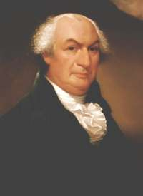
New Jersey Plan
Favored small states
Created by William Paterson
Based on Equal Representation
Each state received 1 vote regardless of its size (population)
Congress could elect weak executive branch (weak federal government)
Congress could set taxes and regulate trade

Slide 5
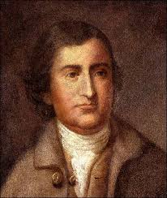
Virginia PLan
Favored large states
Created by Edmond Randolph
Based on a two House Legislature
The number of representatives a state has is based on population
Sets up a 3 branch government-Executive, Legislative, Judicial
Strong Federal Government

Slide 6
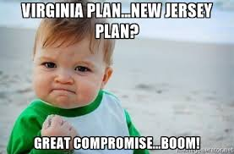
Compromise, Compromise, Compromise!

Slide 7
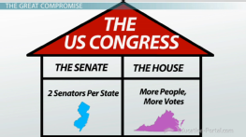
The great Compromise
AKA the Connecticut Compromise
Created by Roger Sherman
Three Branches of Government
Proposed a 2 house legislature to benefit the large AND the small states
House of Representatives-based on population
Senate-based on equal representation

Slide 8
3/5th Compromise
Needed to address the issue of slavery
Southern states wanted to include slaves in their population to gain more seats in the House of Representatives
Northern states argued that slaves were considered property therefore should not be included in population BUT should be taxed
They decided to count each slave as 3/5 of a person for both taxation and representation

Slide 9
What is the Constitution?
Supreme law of the land (“Rulebook” )
Gives citizens, states and federal government rights and powers
Includes representative democracy, separation of power and checks and balances
Three Branches of Government:
Legislative Branch
Judicial Branch
Executive Branch

Slide 10
Whiskey and Fries’s Rebellion
Reading Purpose:
How could the new Constitution stop two important rebellions?
To-Do List:
Number the Paragraphs
Mark the text (based on the reading purpose)
Answer the reading purpose
Complete the Crossword puzzle

Slide 11
The ARticles of Confederation Vs. The Constitution
How are they the same? How are they different?

Slide 12
